Slide 1
MS-FIN Program
FIN 525
Investment Strategies
Mon/Wed
Professor: Werner Bonadurer

Slide 2
Program Session 1
Course Introduction and Overview
Investment Management
Lecture and Discussion
  Anatomy Credit and Financial Crises
Lecture and Discussion
  Asset Classes and Financial Instruments
    Chapter 2 BKM
  Introduction to Risk, Return and the Historical Record
    Chapter 5 BKM

Slide 3
Introduction
Instructor: Dr. Werner Bonadurer, PhD
Clinical Professor of Finance, ASU W.P. Carey School of Business (since 2008)
Faculty Director MSc. in Finance Program 2014-2017
Faculty Leader IBIS Program 2014-Present
Education
B.A., Business Administration, Zurich University of Applied Sciences (1982)
MBA, Finance, Wharton School, University of Pennsylvania (2002)
PhD, Finance and Banking, University of St. Gallen, Switzerland (2007)
Professional Experience
Joint Chief Operating Officer, UBS Warburg Dillon Read, London
Global Head Trading and Sales, Member of Group Exec. Board, UBS
CEO UBS Hong Kong, Deputy Regional Head Asia
Analyst / staff positions in Zurich, New York, Singapore, Hong Kong, London

Slide 4
Course Description and Objectives
Survey selected theory and practice of investment management
Present principles of risk and return, portfolio diversification, asset allocation, efficient markets, active portfolio management, portfolio evaluation, alternative investment strategies
Integrate discussion of theory, empirical evidence and case study applications
Build upon theoretical knowledge acquired in Q1

Slide 5
Organization and Delivery
Market Moving Events
Short Lectures
  Selective review textbook theory
  Discussion textbook problems
Case studies
  Application of theory
Class attendance
Study groups (4-5 students)
Canvas as communication platform
Office hours and appointments

Slide 6
Course Materials
Textbook (mandatory)
Investments by Bodie, Kane, Marcus, 11th or earlier edition
See also student resources and supplements
Cases (mandatory)
Deutsche Bank: Discussing Equity Risk Premium (HBS 9-205-040)
Martingale Asset Management LP in 2008 (HBS 9-209-047)
Dimensional Fund Advisors (HBS 9-203-026)
Pine Street Capital (HBS 9-201-071)
AQR’s Delta Strategy (HBS 9-212-038)
Investment Policy at the Hewlett Foundation (2005) (HBS 9-205-126)
Principal-Protected Equity-Linked Note (Darden UV7126)
Optional Reading
WSJ, FT, The Economist

Slide 7
Grading and Course Requirements
Test Item | Weight | Date
Quiz | 10% | Wed, Oct 30
Midterm exam | 25% | Wed, Nov 13
Final exam | 25% | Wed, Dec 11
Case study write-up group work | 15% | n/a
Portfolio building group work (C-S) | 15% | Wed, Dec 9
Participation and contribution | 10% | Ongoing

Slide 8
Grading Policy
Performance Level | Grade
At least 90% | A- or above
At least 80% | B- or above
At least 70% | C
First grading criteria: Absolute performance (performance level) Second grading criteria: Distribution across class (curved grading); diffulty level of exams

Slide 9
Case Study – Group Work
Written, hand-in case analysis per study group
Choose from among four cases:
  Martingale Asset Management LP in 2008 (HBS 9-201-061)
  Pine Street Capital (HBS 9-201-071)
  AQR’s Delta Strategy (HBS 9-212-038)
  Investment Policy at the Hewlett Foundation (2005) (HBS 9-205-126)
Length max. eight pages, plus exhibits
Hand-in prior to case discussion
Case analysis counts for 15 percent of overall grade
  20 percent based on style, syntax, organization, professionalism of write-up
  80 percent based on quality of analysis
Several case questions are listed on Canvas (see case study instructions)

Slide 10
Case Discussion in Class
Commit to “4 Ps” of involvement in case discussion
  Preparation, Presence, Promptness, Participation
Students will be randomly selected to have a “crack” at analysis
Joint development of summary and take-away points
Opportunity to earn a good grade in case discussion/class participation

Slide 11
Miscellaneous
Formation of Study Groups by not later than Wed, Oct 30
Ongoing Feedback
“Duplication” with Managerial Finance?
Grade Appeals/Changes
W.P. Carey School of Business Honor Code
Your Expectations? Concerns?

Slide 12
Investment Management
Investors face two unknowns:
1) They don’t know what will happen; and
2) They don’t know how the market will respond
Making it even harder, there is no way to be sure afterward why the market did what it did…

Slide 13
Investment Management
Here is an example: U.S. / China Trade Deal
Will not happen?
Will happen?
  If so, how significant will it be? Partial deal?
  How it will affect the market?
    Longs?
    Shorts?
  Is any deal already priced-in? Fully? Partially?
  Or did the market price in other events (global economy, recession risks, debt levels, etc.)?

Slide 14
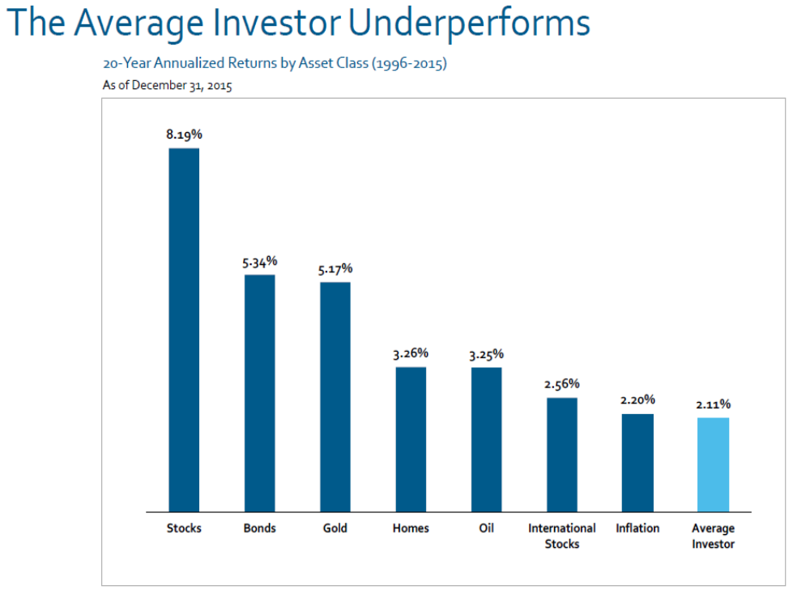

Slide 15
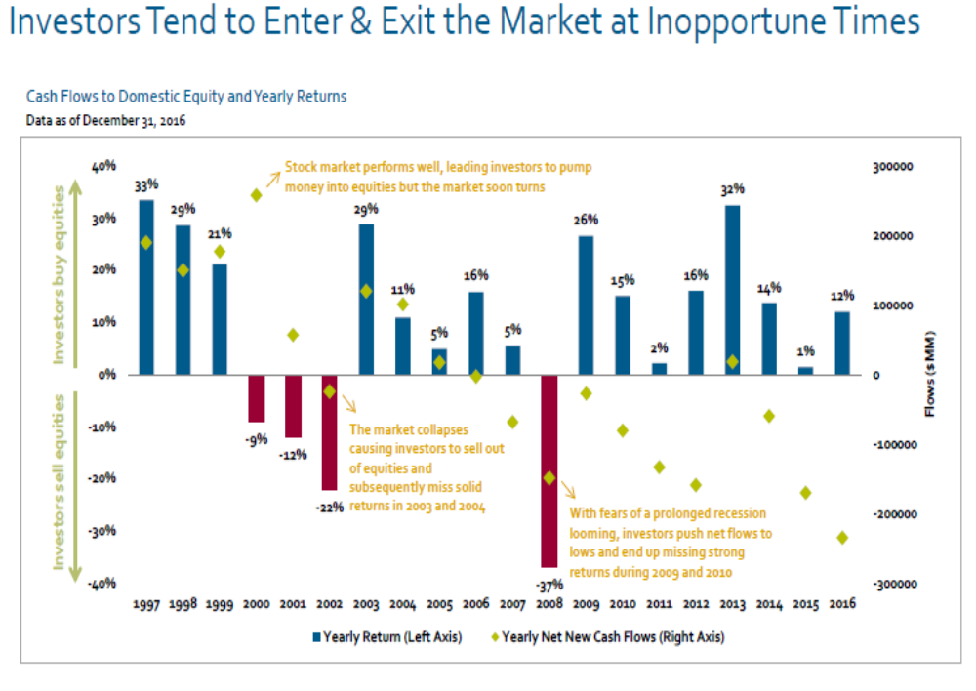

Slide 16
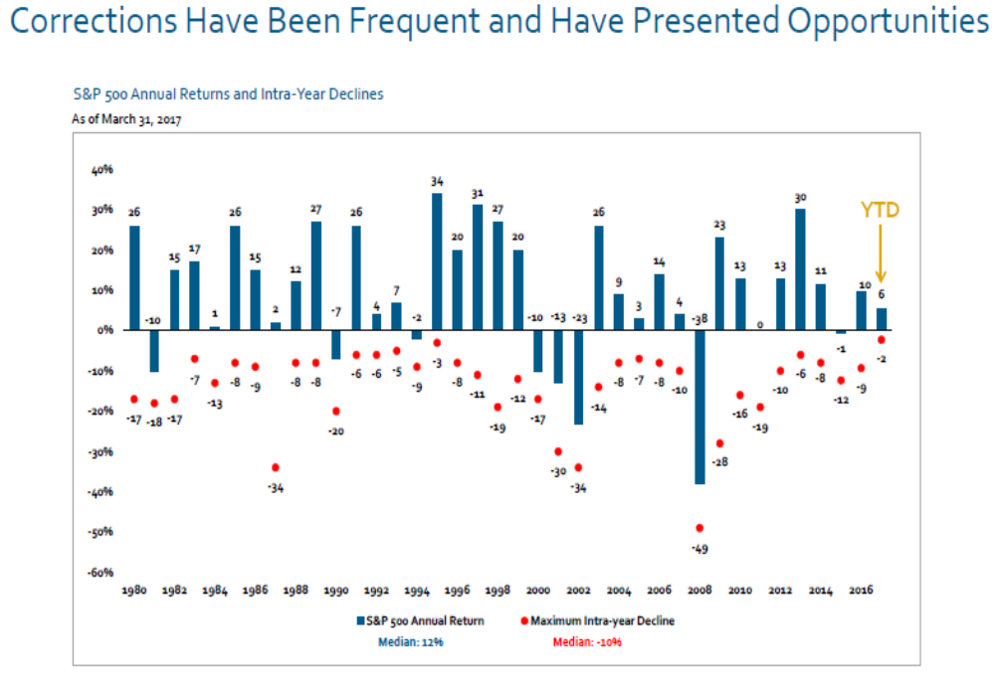

Slide 17
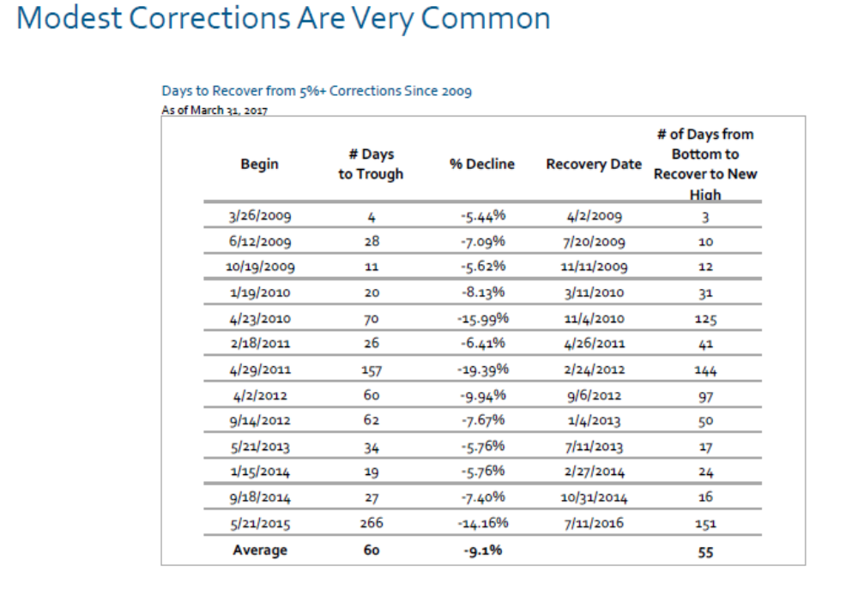

Slide 18
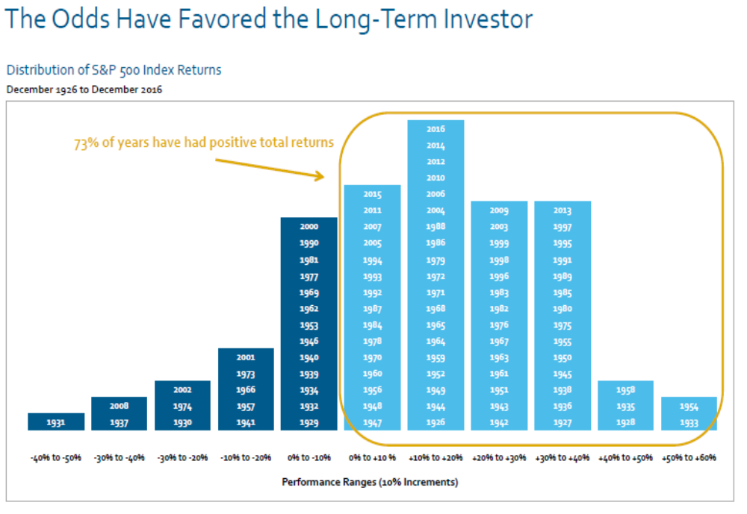

Slide 19
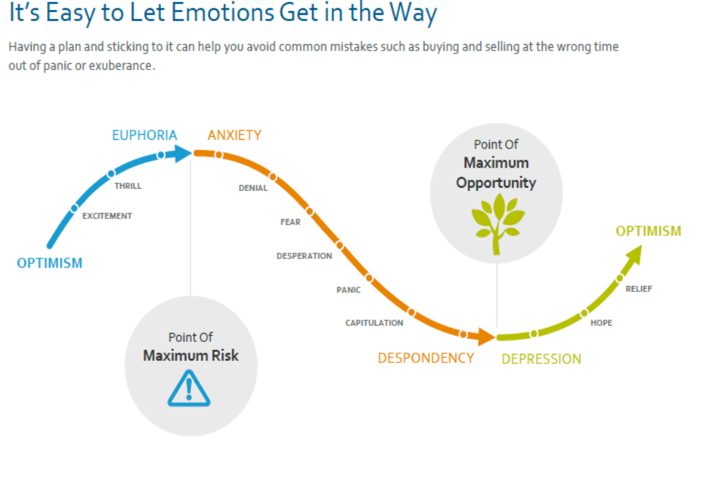

Slide 20
Investment Management
Strategy | Bills | Equities | Perfect Timer | Imperfect Timer
$1 growth: Jan 1926 to Dec 2009 | $20.47 | $2,150 | $207,057 | $5,607
SD | 3.11% | 20.56% | 14.04% | 14.59%
LPSD | 0% | 16.42% | 0% | 26.03%
William Sharpe: “… 91.5% of the variation in returns of large sample
of mutual funds could be explained by the funds’ asset allocation to
bills, bonds, and stocks…” Later studies found that as much as 97%
of fund returns can be explained by asset allocation alone.

Slide 21
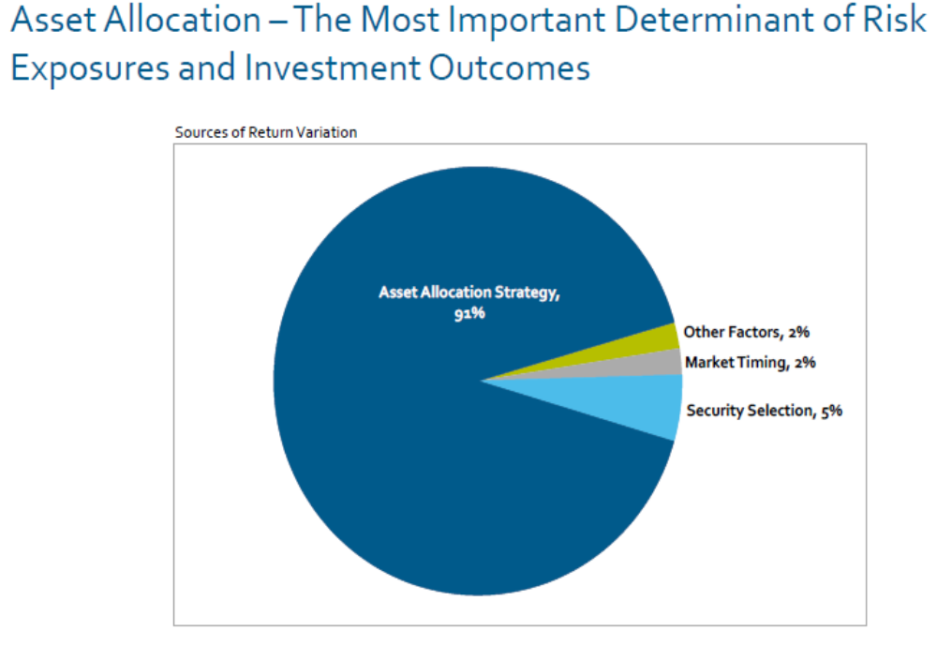

Slide 22
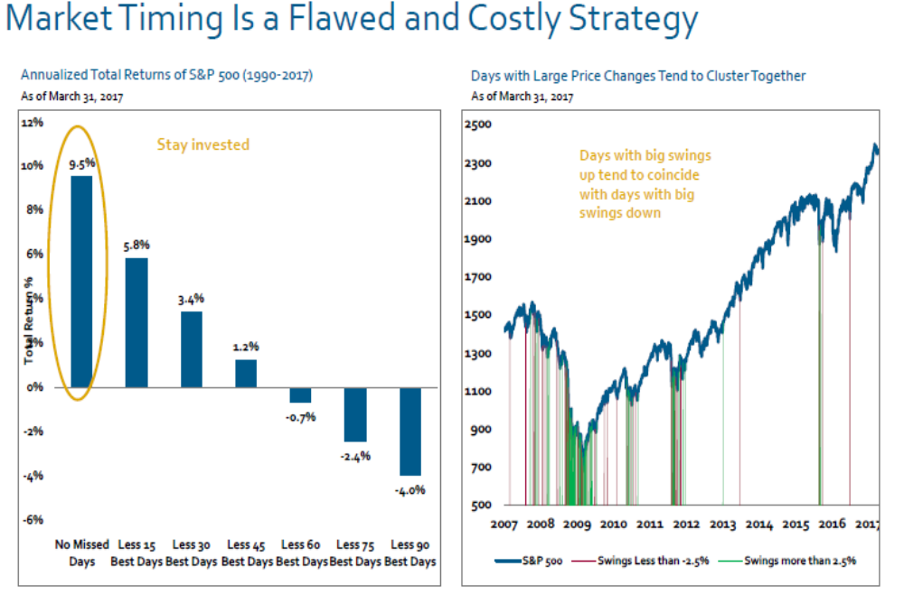

Slide 23
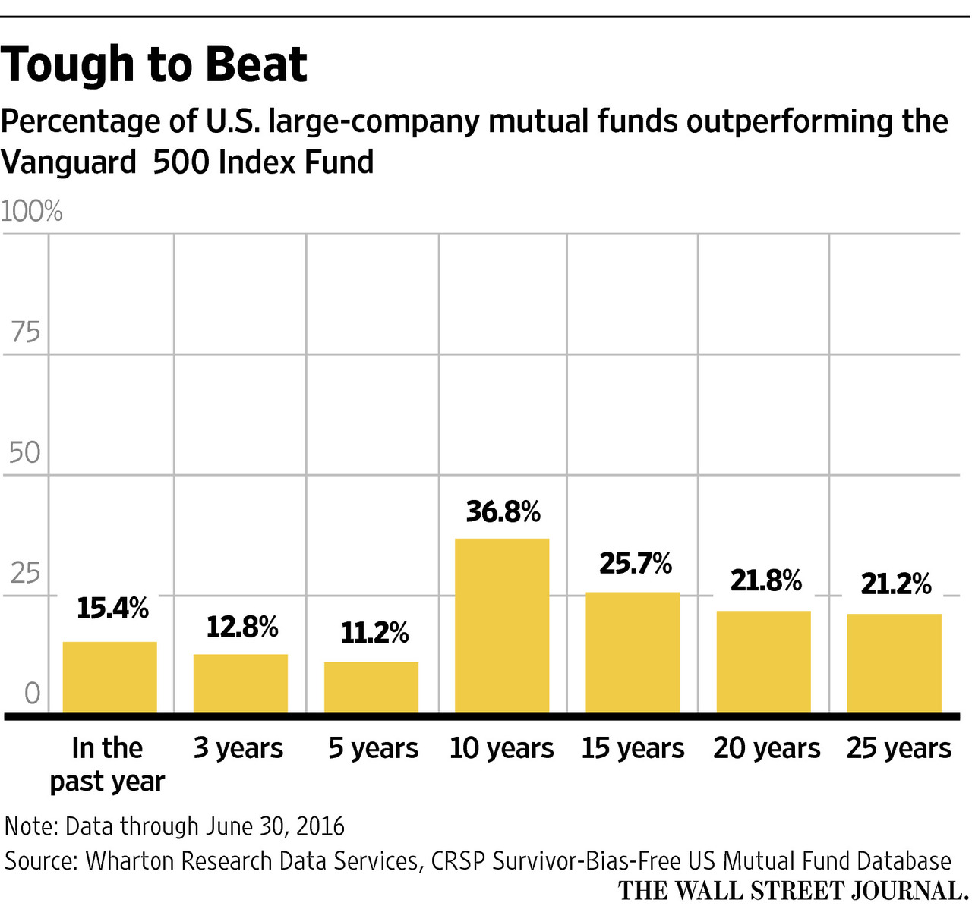

Slide 24
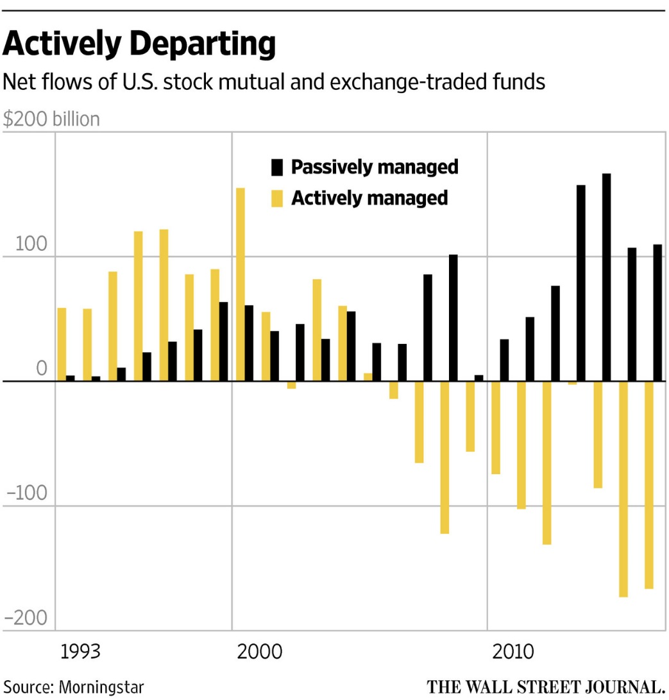

Slide 25
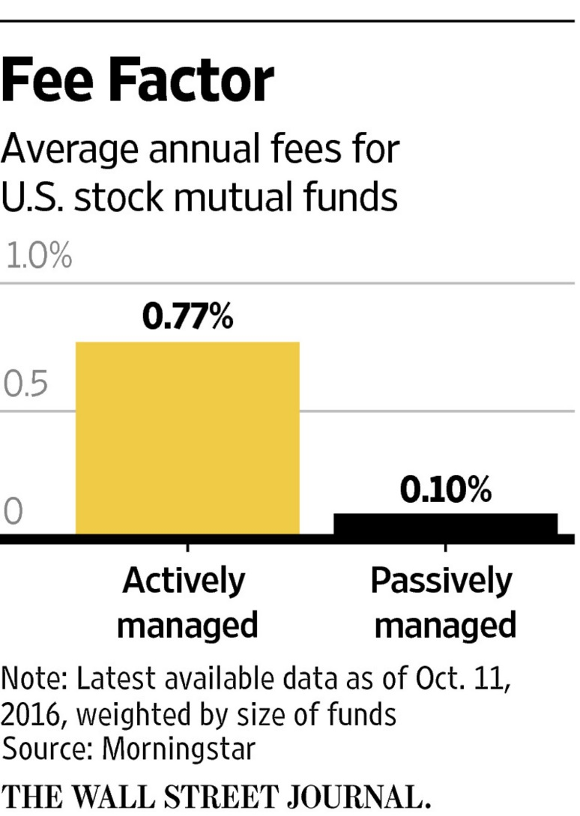

Slide 26
Investment Management
First: Analyze…
  Need to have a “view of the world”
    Scenarios
    Probabilities
    Reading signals
Second: Apply…
  Need to understand risks/rewards
    Asset classes
    Securities
    Investment strategies

Slide 27

Financial Crises

Slide 28
Financial Crises
Which is the most commonly repeated and most expensive investment advice ever given?

Slide 29
Financial Crises
“This Time is Different”
“…financial crises are things that happen to other people in other countries at other times; crises do not happen to us, here and now. We are doing things better, we are smarter, we have learned form past mistakes. The old rules of valuation no longer apply.”
(Reinhard, Rogoff; 2010)
“There is nothing new except what is forgotten.”
(Rose Bertin)

Slide 30
Financial Crises
We have been there before
Remarkable similarities
Recognizing analogies and precedents is essential steps to
  Reduce risk of future crises
  Better handle catastrophes when they happen

Slide 31
And Even the U.S. Had its Fair Share
Panic of 1792: A financial credit crisis due to speculation resulted in bank runs. Banks were bailed out.
Panic of 1873: A severe banking crisis resulted in a six-year economic depression.
Western Blizzard, 1857: A crisis due to excessive foreign imports and the rapid construction of railroads (the dot-com bubble of that era) on borrowed and speculative capital led to bank failures.
Post-Civil War Panic, 1865 – 1869: Financial uncertainty followed the American Civil War.
Panic of 1873: Overexpansion form the railroad industry, an economic downturn in Europe and a contradiction in the money supply led to bank failures and a six-year economic depression.
Panic of 1884: During the recession of 1882 – 1885, New York City national banks called in outstanding loans and worsened the crisis, resulting in the failure of 10,000 investment firms.
Panic of 1893: Numerous bank failures, due to the collapse of railroad construction, excessive debt levels and high demand for gold, led to the most serious economic depression experienced by the United States thus far.
Panic of 1901: The first stock market crash occurred on the New York Stock Exchange due to parties vying for control of the Northern Pacific Railway.
Bankers’ Panic of 1907: During an economic recession, the New York Stock Exchange fell 50% from its highs the previous year, and led to runs on banks and trust companies.
Depression of 1920 – 1921: A sharp deflationary recession followed the end of WWI.
Great Depressions 1929 – 1933.
Kennedy Slide, 1962: The S&P fell 23% after rising steadily since the 1940s, triggering a bear market.
Stock Market Crash, 1973 – 1974.
Stock Market Crash, 1987.
Dot-com Crash, 2000 – 2001.
The Great Credit and Financial Market Crisis, 2008 – 2009.

Slide 32
Financial Crises
“Economic theory proposes plausible reasons that financial markets, particularly ones reliant on leverage, can be quite fragile and subject to crises of confidence. Unfortunately, theory gives little guidance on the exact timing or duration of these crises, which is why we focus so on experience.” (Reinhard, Rogoff; 2009)

Slide 33
Types of Financial Crises
Sovereign defaults
Banking crises
Exchange rate crises
Inflation crises
  Excessive debt accumulation
    Governments
    Banks
    Corporations
    Consumers

Slide 34
Defining Crises
Crisis Type | Threshold and/or Definition
Inflation | Annual inflation rate of 20% or higher
Currency crash | Annual depreciation versus USD (or other relevant currency) of 15% or more
Currency debasement (type I) | Reduction in metallic content of coins of 5% or more
Currency debasement (type II) | Currency reform whereby a new currency replaces a much-depreciated earlier currency
Banking crisis | Bank runs leading to closure, take-over, etc. Large-scale government assistance
Debt crisis External | Sovereign default
Debt crisis Domestic | Sovereign default, freezing of bank deposits, forcible conversions from USD to local currency
Source: Reinhart, Rogoff (2009)

Slide 35
Development of a
Typical Financial Crisis
Displacement
Credit Expansion
Demand and Supply Cycle
Overtrading
Specific Signal
Revulsion
Source: Charles P. Kindleberger, Manias, Panics, and Crashes: A History of financial Crisis (USA: Basic books, 1989), pg 16-23

Slide 36
Some Warning Signals
Large (short term) portfolio capital inflows
Excessive yield-chasing and run for risky assets
Big monetary expansion
Massive increase in bank lending and weak banking sector
High and rising inflation
Build-up of asset bubbles (e.g., real estate prices)
Rapid increase in real exchange rate
Rising (external) debt levels
Unsustainable government budget deficits
Increasing level of financial leverage in economy
Global imbalances
Erosion of FX reserves and unsustainable pegging

Slide 37
What Will Trigger the Next Crisis?
Another crisis will arrive, for sure
Synchronized global recession?
Limits and end of monetary policy?
Debt-related crash in China, corporate and consumer debt in the U.S.?
Political or geopolitical-related crash?
Escalation of trade war?
Crash because of sell-off bond markets (like ‘94)?
Crash due to equity (over-)valuation?
Financial stress because of high USD?
Inflation risk?

Slide 38
How to Spot a Financial Crisis before it Spots You
https://www.ft.com/video/4171c942-853a-4f7b-844e-4c48ef170cbb

Slide 39
The Asian Currency Crisis 1997/98

Slide 40
What developments led to the Asian currency crisis in 1997-1998?
Domestic macroeconomic problems in Thailand
  1990-1996: Rapid GDP and export growth; attractive site for investment
  Large (short term) capital inflows and expansion domestic lending
  USD strengthening against JPY and EUR (Baht remained pegged to USD)
  Big monetary expansion to keep domestic currency stable
  Build up of asset bubble and high inflation -> Real XR rate up; EXP down; GDP down; Unemployment up; CA deficit up; large capital outflows
Failure in international capital markets
  Inadequate risk assessment; yield-chasing
  Herd-behavior; moral hazard (bail-out put)
  Local financial system too dependent of foreign capital
Crony capitalism
  Mis-allocation of capital

Slide 41
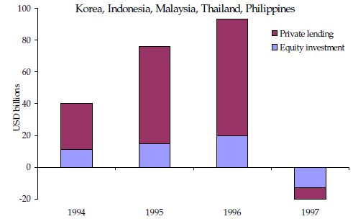
Capital flows
Capital inflows increasing
Speculative or ’hot money’ inflows
Inflating variety of asset classes (real estate, stock market etc.)

Slide 42
The U.S. Credit Crisis of 2008

Slide 43
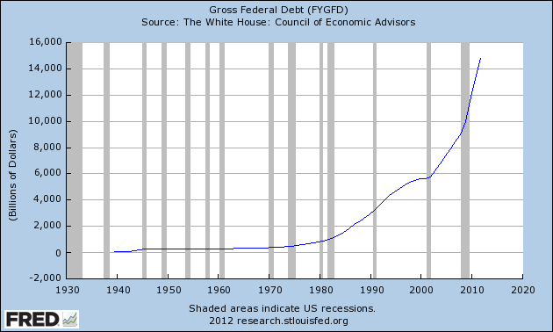
Federal Government Debt
The sky is the limit…
I=58k; C=75k; D=327k

Slide 44
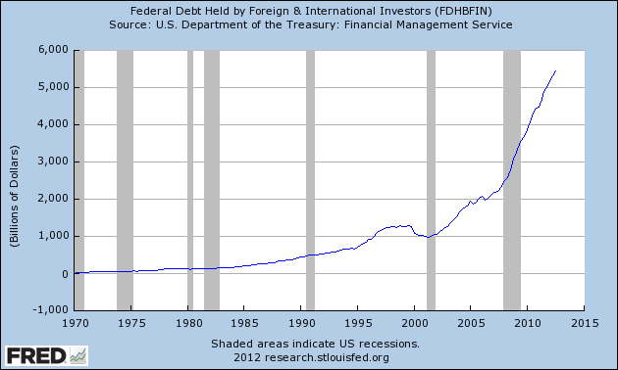
Federal Debt Held by Foreigners
Unlimited appetite by
Japan, China, Middle
East Funds, Europe
etc.? Consequences?

Slide 45
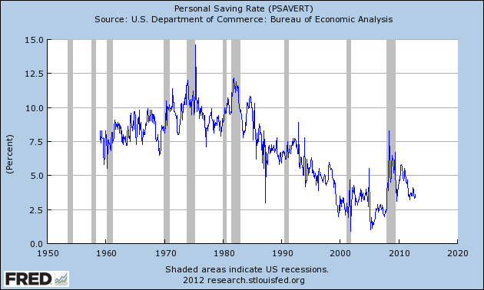
U.S. Personal Savings Rate
Less savings and more
debt is the way to go…

Slide 46
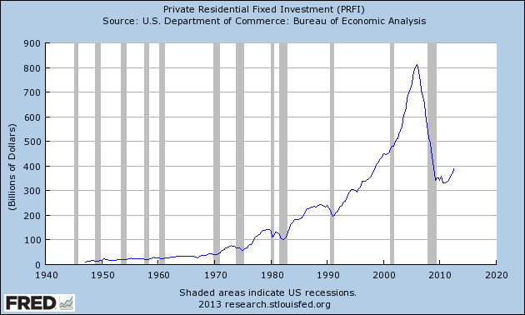
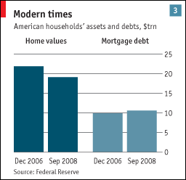
Private Residential Investment
Unlimited speculation?
$4 trillion lost in less than
two years!

Slide 47
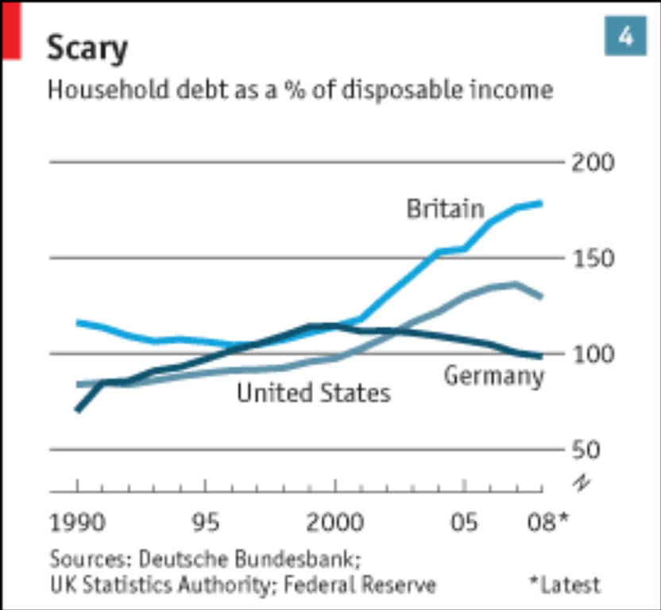
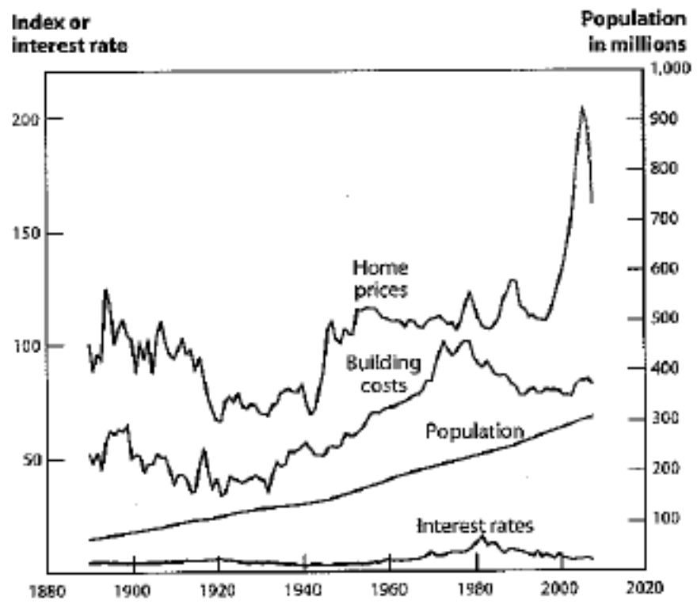
Household Debt
Housing/Economic Fundamentals
Source: “Taming the Beast,” The Economist, 10/19/08
Source: Robert Shiller, “the Subprime Solution,” pg 33. 2008

Slide 48
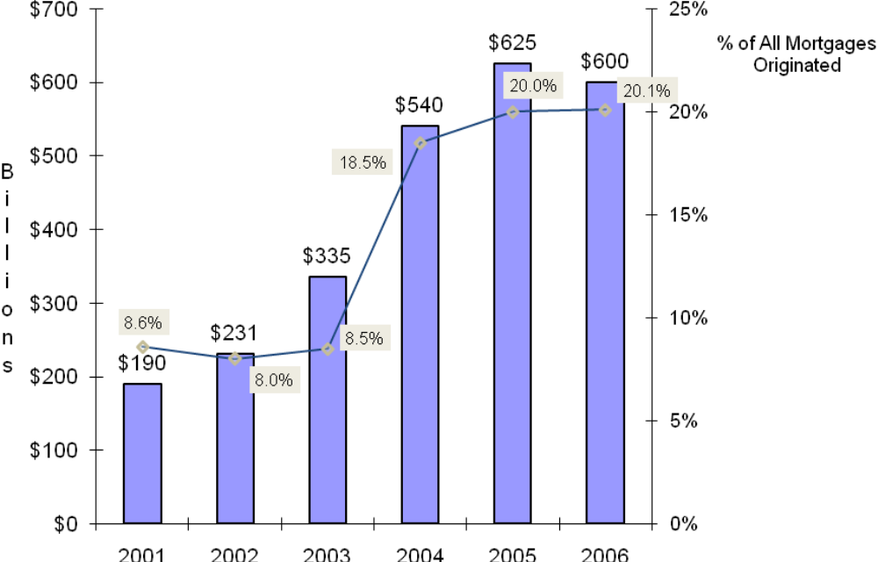
Growth in U.S. Subprime Mortgages
Population growth (low income)
+
Real estate price escalation
+
Rampant speculation
+
Financial innovation
=
Subprime mortgage explosion

Slide 49
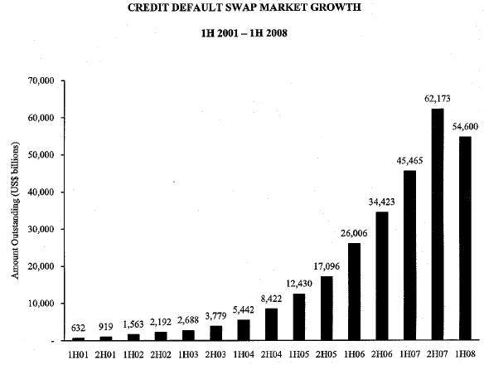
Credit Default Swap Market Growth
1H 2001 – 1H 2008
Growing under the radar screen?
Transparency? Regulation? Common
sense?
Source: Financial Times and the International Swaps and Derivatives Association. Cambridge Associates, 2008

Slide 50
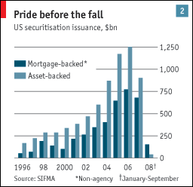
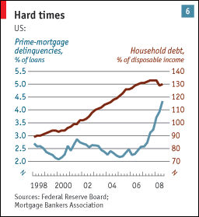
U.S. Securitization Issuance
Prime-Mortgage Delinquencies
Source: The Economist, January 24, 2009
Source: The Economist, January 24, 2009

Slide 51
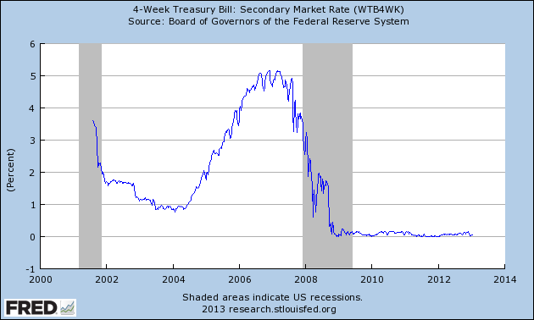
Treasury Bill Rate
Tightening at the
short end of the
curve…

Slide 52
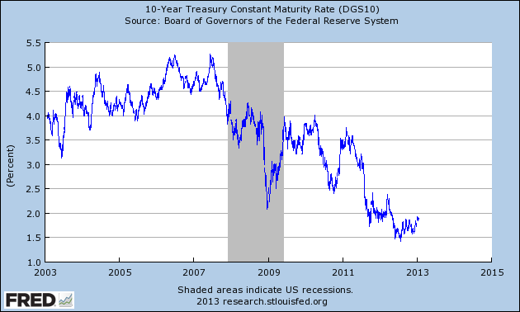
10-Year Treasury Bond
… did not lead to a similar
change at the long end…

Slide 53
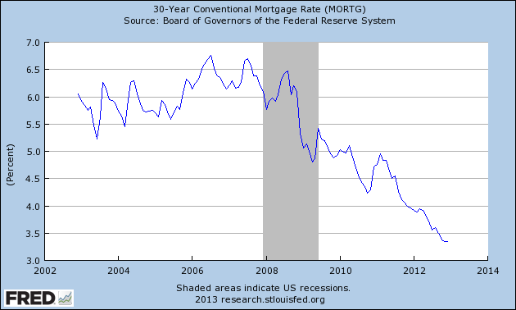
30-Year Mortgage Rate
… and mortgage rates did barely
move. Where was the cooling down
effect, if there was any? Was there
an 800 pound gorilla in the room?

Slide 54
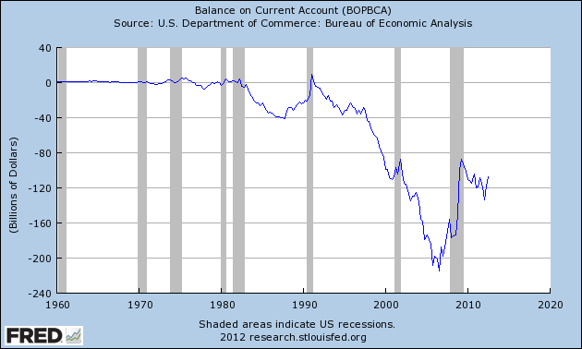
U.S. Current Account
Falling in love with importing
way more than exporting. That’s
fine, but remember consequences
in the Capital Account…

Slide 55
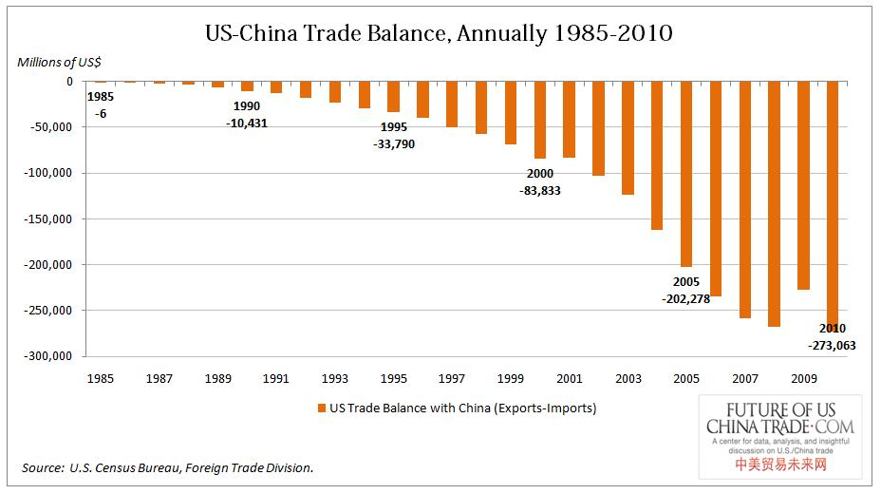
U.S. – China Trade Balance
Can we simply blame the
“undervalued” RMB? What else?

Slide 56
Global Imbalances
Savings glut in China, Japan, Germany, etc.
Recycling of USD holdings
The USD yield curve conundrum
Building-up of asset bubbles
Innovation and securitization
Yield-chasing (a.k.a. greed) and MBS
The USD trap

Slide 57
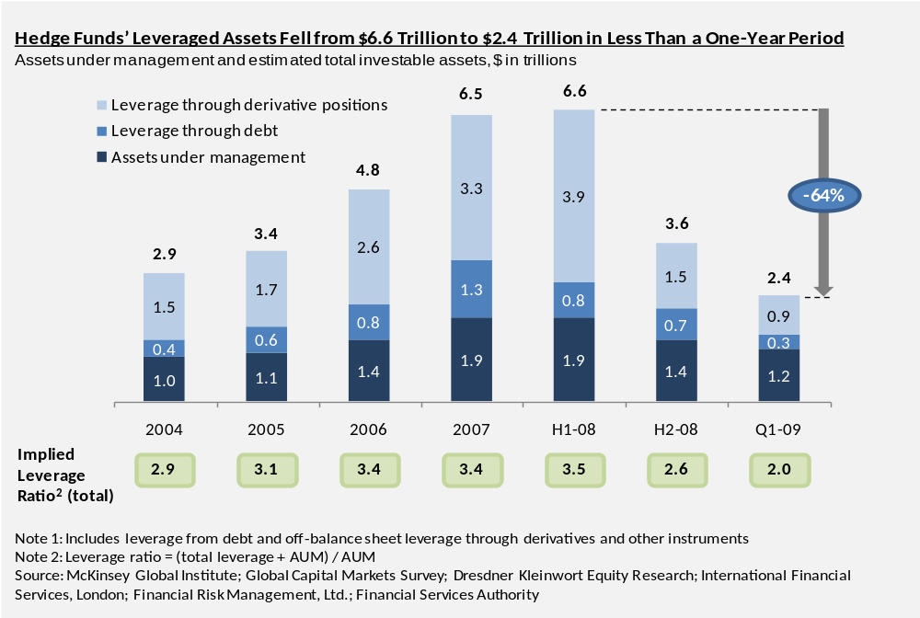
Leverage Dropped During 2008
Notes:
Not anything exactly the same info in Word document

Slide 58
Background of the Crisis
First Warning Signs
  Mounting macro economic imbalances
  Massive increase in debt, leverage, securitization, subprime lending
  Classic asset bubble signs
  Peaking real estate investments in 2006
  Pick-up in subprime delinquencies in 2006
  ABX markets deterioration in Jan/Feb 2007
  Collapse Bear Stearns hedge funds in Jul 2007

Slide 59
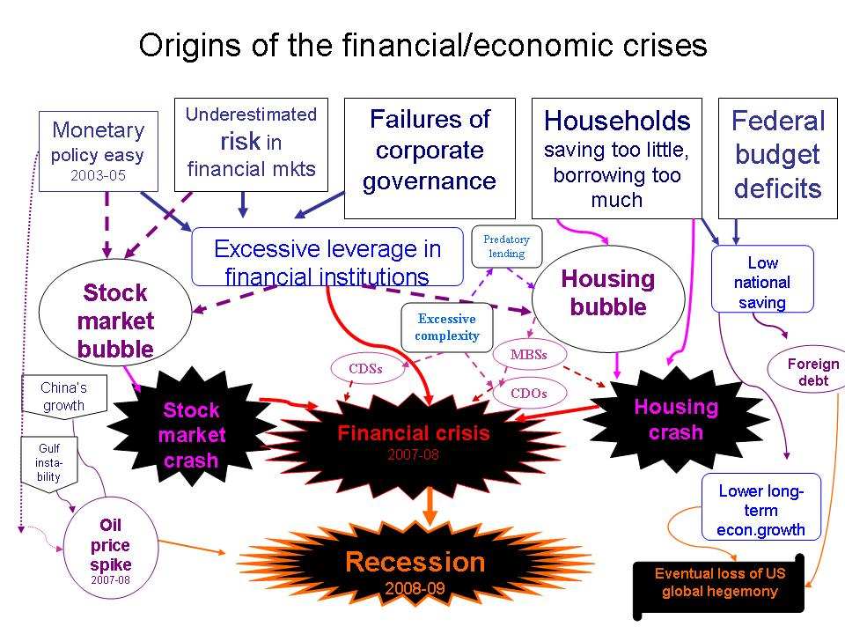
Why Did It Happen?

Slide 60
Explanations of the Crisis
Human Excesses
False Beliefs
Securitization
Monetary policy
Structure of Incentives
Financial Transparency
Misguided Ratings
Lax or Absent Regulation

Slide 61
The European Sovereign Debt Crisis

Slide 62
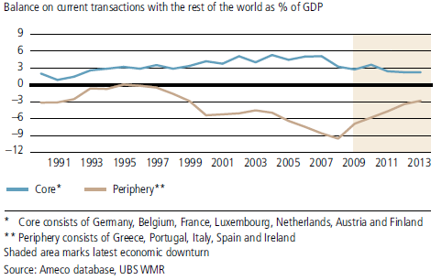
Persistent Current Account Imbalances
EU access:
interest rates down
  spread narrowing across EU
borrowing up
spending and debt up
consumption up
wages up
welfare up
  closing the gap
Leading to:
inflation up
imports up (strong EUR)
exports down
  f(strong EUR, lost price
  competitiveness, low
  productivity)
Lost monetary flexibility; devaluation was not an open any longer

Slide 63
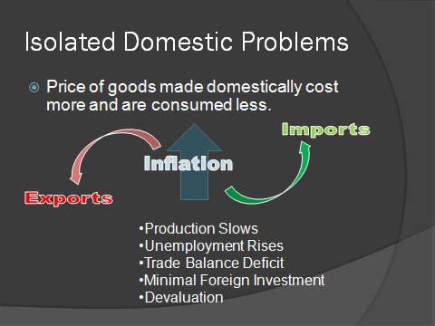
Loss of competitiveness
Real XR too high

Slide 64
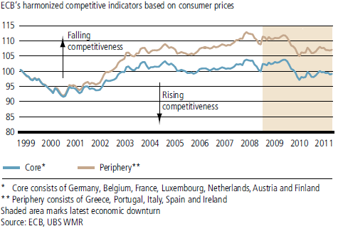
Diverging Competitiveness
Real exchange rate (e.g.):
If price of a basket of Greek goods
increased in terms of the same basket
of German goods → real XR of Greece
increases → loss of competitiveness;
boon for Greek imports; bust for Greek
exports…

Slide 65
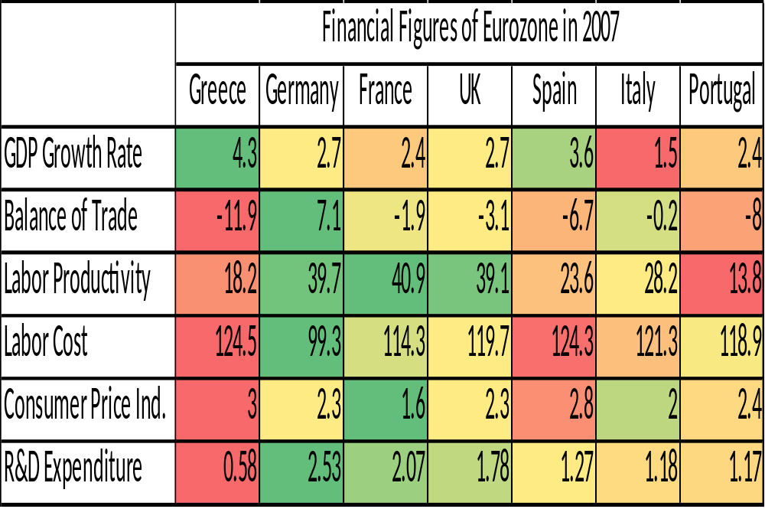

Slide 66
Financial Health Thermometers - Indicators
Bank Liquidity
Spread of 3-month LIBOR over central bank target rate
Corporate default
Difference between corporate bond and government bond rates
Financial intermediaries default
Five-year credit default swap spread of financial sector (cost of
insuring an underlying credit security against default)
Equity volatility
Implied volatility of major stock market indices

Slide 67
Early Warning Indicators of Banking and Currency Crises: A Summary
Indicator (best to worst) | Description | Frequency
Banking Crisis Best Real exchange rate Real housing prices Short-term capital inflows/GDP Current account balance/investment Real stock prices Worst Institutional Investor and Moody’s Terms of trade | Deviation from trend Annual percentage change In percentage points In percentage points Twelve-month percentage change Change in index Twelve-month percentage change | Monthly Monthly, quarterly, annually Annually Annually Monthly Biannually (II), monthly (Moody’s) Monthly
Currency Crisis Best Real exchange rate Banking crisis Current account balance/GDP Real stock prices Exports M2 (broad money)/int. reserves Worst Institutional Investor and Moody’s Domestic-foreign interest differential (lending rate) | Deviation from trend Dichotomous variable In percentage points Twelve-month percentage change Twelve-month percentage change Twelve-month percentage change Change in index In percentage points | Monthly Monthly or annually Annually Monthly Monthly Monthly Biannually (II), monthly (Moody’s) Monthly
Sources: Kaminsky, Lizondo, and Reinhart (1998), Kaminsky and Reinhart (1999), Goldstein, Kaminsky, and Reinhart (2000), and Reinhart, Rogoff’s calculation (2010)

